Slide 1



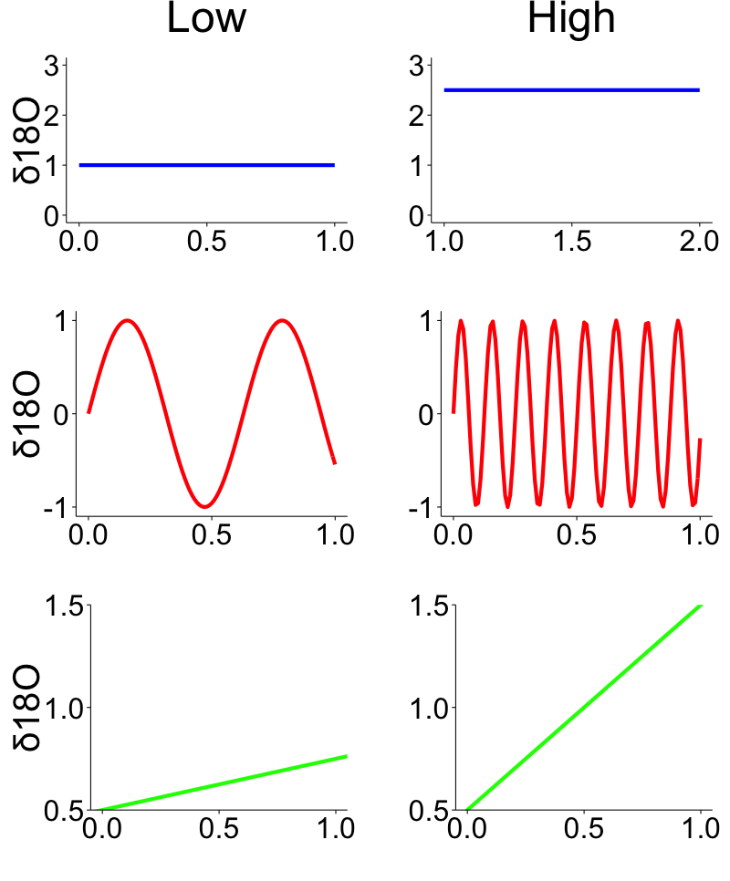

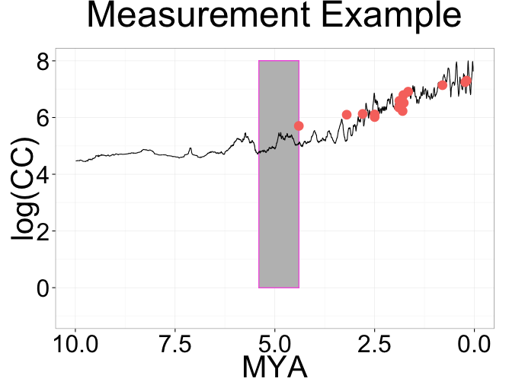
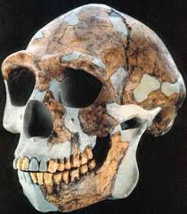
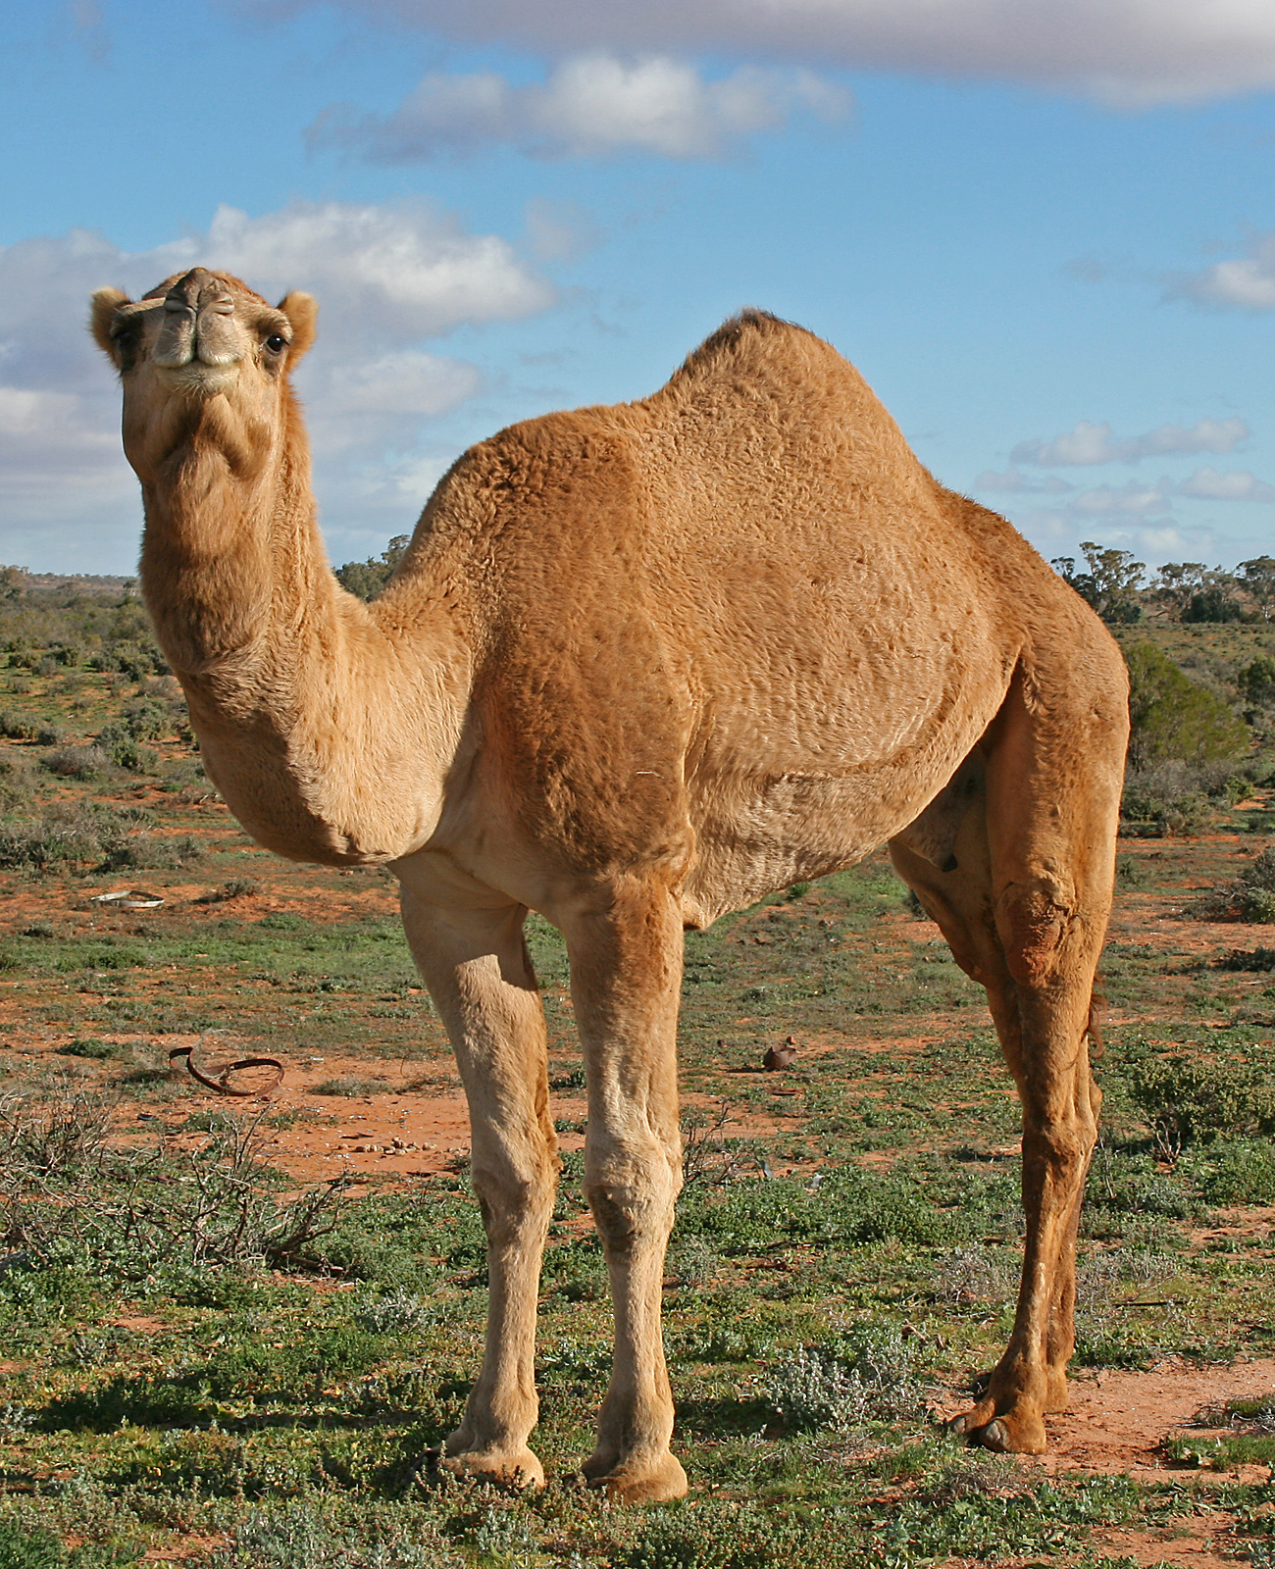



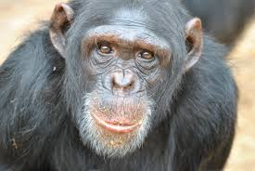

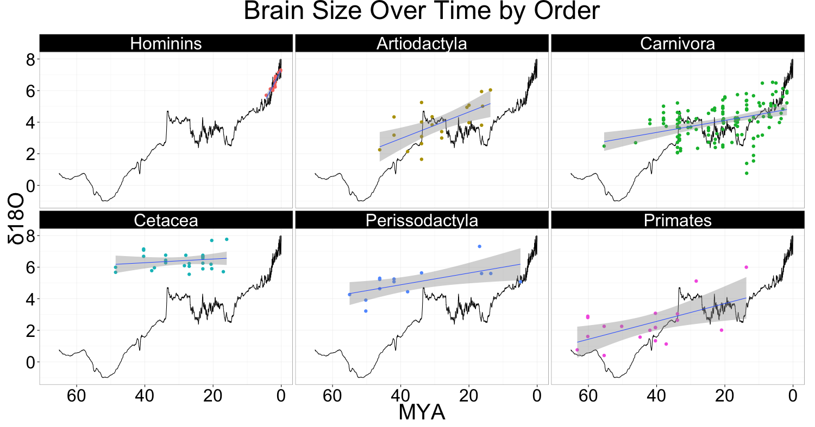
The Effects of Climatic Trends, Variability, and Rates of Change on Mammalian Brain Evolution
B. M. Schilder¹, W. A. Barr¹, R. Bobe¹, & C. C. Sherwood¹
¹Center for Advanced Study of Human Paleobiology,
Department of Anthropology, The George Washington University
INTRODUCTION
RESULTS II
Previous studies have investigated the influence of large-scale global climate changes in temperature or vegetation on the local ecology of hominins. Absolute brain size has been shown to be a predictor of innovation and success when mammals are introduced to novel environments (Sol et al., 2008). Variability selection posits that environmental fluctuations drove hominin versatility in the form of increased brain size, whereas trend selection hypothesizes that brain size was driven by unidirectional trends towards increased aridity and global cooling (Potts, 2012). However, previous studies have only tested limited subsets of climatic variables, measures of brain size, time intervals, and taxa (Ash & Gallup, 2007; Bailey & Geary, 2009; Shultz & Maslin, 2013). Most problematically, these climatic hypotheses of brain evolution are not mutually exclusive. Therefore, this study investigated the relative contribution of variability selection, trend selection, as well as rate selection (the speed at which the environment shifts) on fossil mammal cranial capacity (N=222) using multiple regression models.
Separated by Order
Hominins vs. Carnivores
63.0
Hominins vs. Carnivores
Responsiveness (Regression Coefficients)
Responsiveness (Regression Coefficients)
MATERIALS AND METHODS
96.8
Measured δ18O mean, SD, slope for preceding time interval from fossil date
Performed multiple regressions in R Studio with each measure as a predictor of CC
Trend
(Mean)
Hominins
Carnivora
Variability
(SD)
Responsiveness was defined as the coefficient estimate of the multiple regression.
Patterns and degrees of responsiveness differed across Orders and time intervals.
Hominin, Carnivore, Perrissodactly, and Primate brains were responsive to global climate.
An investigation of species from only the last 5MY revealed that Hominins and Carnivora responded very differently to climatic shifts during this time period.
Rate
(Slope)
Data References: Boddy et al. (2010); Shultz, Nelson, & Dunbar (2012); Schoenemann & Begun (2013); Zachos et al. (2001)
CONCLUSIONS
RESULTS I
Brain size has not increased over time in all mammals, and only some Orders respond to global climate change by increasing brain size.
Hominin brains were highly responsive to global cooling (and not shifts in global variability or rates of change), possibly reflecting evolutionary changes to their ecological niche.
The ecologies of Hominins and Carnivores were affected differently by climatic change in the last 5MY, making Carnivores a poor model for Hominin evolution in this respect.
OLS regressions of brain size vs. time
Mammals as a whole increased brain size over time, however…
Degree of brain size increase over time differed across Orders
FUTURE DIRECTIONS
Repeat multiple regression analyses using ancestral state reconstructions of brain size derived from extant species’ brain size.
Inclusion of Carbon isotope record measures over the last 15My as additional predictors of brain size.
R² = 0.846
R² = 0.404
R² = 0.139
ACKNOWLEDGEMENTS
Many thanks to B. Wood, B. Richmond, & J. Kingston for their invaluable advice, and to my fellow CASHP students for much needed moral support. This project was supported with funding from IGERT (NSF).
References:
Ash, J., Gallup, G.G., Jr., 2007. Paleoclimatic Variation and Brain Expansion during Human Evolution. Human Nature. 18, 109–124.
Bailey, D.H., Geary, D.C., 2009. Hominid Brain Evolution. Human Nature. 20, 67–79.
Potts, R., 2012. Environmental and Behavioral Evidence Pertaining to the Evolution of Early Homo. Current Anthropology. 53, S299–S317.
Schoenemann, P.T., Begun, D.R., 2013. Hominid brain evolution. A Companion to Paleoanthropology. 136–164.
Shultz, S., Dunbar, R., 2010. Encephalization is not a universal macroevolutionary phenomenon in mammals but is associated with sociality. PNAS. 107, 21582–21586.
Shultz, S., Maslin, M., 2013. Early Human Speciation, Brain Expansion and Dispersal Influenced by African Climate Pulses. PloS one. 8, e76750.
Sol, D., Bacher, S., Reader, S.M., Lefebvre, L., 2008. Brain size predicts the success of mammal species introduced into novel environments. The American naturalist. 172 Suppl 1, S63–71.
Zachos, J., Pagani, M., Sloan, L., Thomas, E., Billups, K., 2001. Trends, rhythms, and aberrations in global climate 65 Ma to present. Science. 292, 686–693.
R² = 0.338
R² = 0.298

